Slide 1

MONGO DB
NAME : VARADHA . N
UID : 161101
MAIL ID : varadha.nair@ust.com
DATE : 10/12/2020

Slide 2
ONE – TO - ONE

Slide 3
> use VehicleDetails
switched to db VehicleDetails
> db.persons.insertOne({"Name":"Varadha","Age":22})
{
"acknowledged" : true,
"insertedId" : ObjectId("5fd1dd4b7e1e8e6c67ba2715")
}
> db.cars.insertOne({"Name":"Scropio","Owner": ObjectId("5fd1dd4b7e1e8e6c67ba2715")})
{
"acknowledged" : true,
"insertedId" : ObjectId("5fd1dd9d7e1e8e6c67ba2716")
}
> db.cars.find().pretty()
{
"_id" : ObjectId("5fd1dd9d7e1e8e6c67ba2716"),
"Name" : "Scropio",
"Owner" : ObjectId("5fd1dd4b7e1e8e6c67ba2715")
}
>

Slide 4
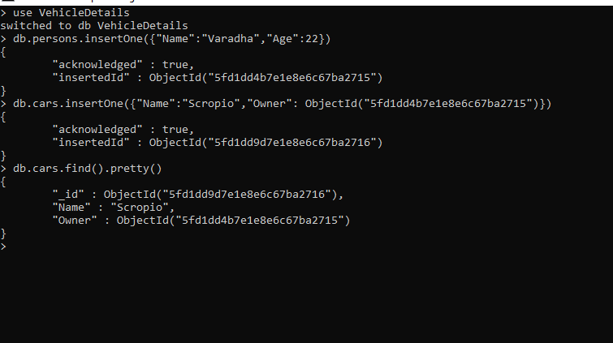

Slide 5
ONE – TO - MANY
> use SweetsShop
switched to db SweetsShop
> db.personDetails.insertOne({"Name":"Midhun","FavSweets":["s1","s2"]})
{
"acknowledged" : true,
"insertedId" : ObjectId("5fd1e047c07dcf4dfc9318e4")
}
> db.personDetails.findOne()
{
"_id" : ObjectId("5fd1e047c07dcf4dfc9318e4"),
"Name" : "Midhun",
"FavSweets" : [
"s1",
"s2"
]
}
>

Slide 6


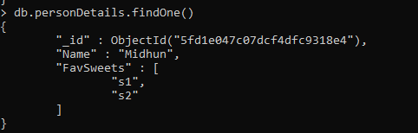

Slide 7
ONE TO MANY – ANOTHER EXAMPLE

Slide 8
> use citizenship
switched to db citizenship
> db.cities.insertOne({"City":"Chennai",Coordinates: {lat:243.56,long:856.25}})
{
"acknowledged" : true,
"insertedId" : ObjectId("5fd1cc447e1e8e6c67ba2710")
}
> db.cities.find().pretty()
{
"_id" : ObjectId("5fd1cc447e1e8e6c67ba2710"),
"City" : "Chennai",
"Coordinates" : {
"lat" : 243.56,
"long" : 856.25
}
}
>

Slide 9
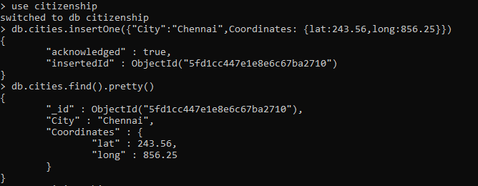

Slide 10
> db.citizens.insertMany([{Name:"Tarun",Age:25,CityId:ObjectId("5fd1cc447e1e8e6c67ba2710")},{Name:"Ashik",Age:45,CityId: ObjectId("5fd1cc447e1e8e6c67ba2710")}])
{
"acknowledged" : true,
"insertedIds" : [
ObjectId("5fd1ce837e1e8e6c67ba2711"),
ObjectId("5fd1ce837e1e8e6c67ba2712")
]
}
>

Slide 11
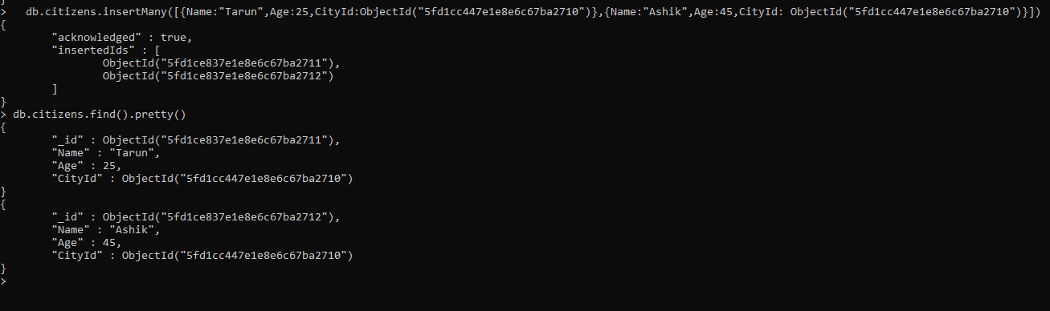

Slide 12
ANOTHER EXAMPLE
> use cart
switched to db cart
> db.customers.insertOne({Name:"Varadha",Age:23})
{
"acknowledged" : true,
"insertedId" : ObjectId("5fd1cf7f7e1e8e6c67ba2713")
}
> db.customers.find().pretty()
{
"_id" : ObjectId("5fd1cf7f7e1e8e6c67ba2713"),
"Name" : "Varadha",
"Age" : 23
}
>

Slide 13
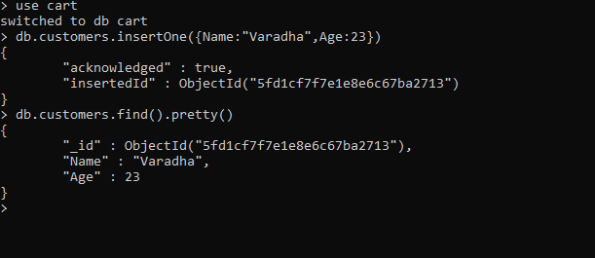

Slide 14
> db.customers.updateOne({},{$set:{Orders:[{ProductId : ObjectId("5fd1d07a7e1e8e6c67ba2714"),Quantity:2}]}})
{ "acknowledged" : true, "matchedCount" : 1, "modifiedCount" : 1 }
> db.customers.find().pretty()
{
"_id" : ObjectId("5fd1cf7f7e1e8e6c67ba2713"),
"Name" : "Varadha",
"Age" : 23,
"Orders" : [
{
"ProductId" : ObjectId("5fd1d07a7e1e8e6c67ba2714"),
"Quantity" : 2
}
]
}
>

Slide 15
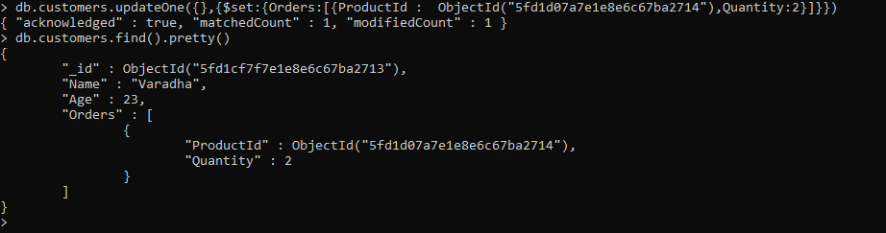

Slide 16
MANY - TO - MANY –> EXAMPLE LIBRARY
> use library
switched to db library
> db.books.insertOne({Title:"I too had a Love Story",Price:230.00,Authors : [{Name:"Chethan"},{Name:"Bagth"}]})
{
"acknowledged" : true,
"insertedId" : ObjectId("5fd1e282c07dcf4dfc9318e5")
}
> db.authors.insertMany([{Name:"Chethan"},{Name:"Bagth"}])
{
"acknowledged" : true,
"insertedIds" : [
ObjectId("5fd1e2b7c07dcf4dfc9318e6"),
ObjectId("5fd1e2b7c07dcf4dfc9318e7")
]
}

Slide 17
> db.books.updateOne({},{$set:{Authors : [ObjectId("5fd1e2b7c07dcf4dfc9318e6"),ObjectId("5fd1e2b7c07dcf4dfc9318e7")]}})
{ "acknowledged" : true, "matchedCount" : 1, "modifiedCount" : 1 }
> db.books.find().pretty()
{
"_id" : ObjectId("5fd1e282c07dcf4dfc9318e5"),
"Title" : "I too had a Love Story",
"Price" : 230,
"Authors" : [
ObjectId("5fd1e2b7c07dcf4dfc9318e6"),
ObjectId("5fd1e2b7c07dcf4dfc9318e7")
]
}
>

Slide 18
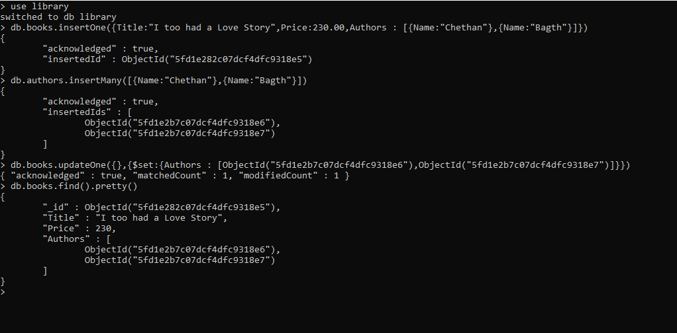

Slide 19
JOINING USING $lookup

Slide 20
> db.books.aggregate( [ { $lookup : { from : "authors" , localField : "Authors" , foreignField : "_id" , as: "Authors" }}]).pretty()
{
"_id" : ObjectId("5fd1e282c07dcf4dfc9318e5"),
"Title" : "I too had a Love Story",
"Price" : 230,
"Authors" : [
{
"_id" : ObjectId("5fd1e2b7c07dcf4dfc9318e6"),
"Name" : "Chethan"
},
{
"_id" : ObjectId("5fd1e2b7c07dcf4dfc9318e7"),
"Name" : "Bagth"
}
]
}
>

Slide 21
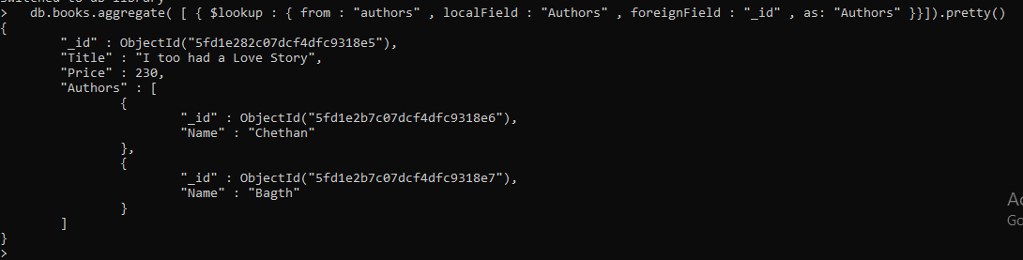

Slide 22
ANOTHER EXAMPLE OF MANY TO MANY
> use purchaseDetails
switched to db purchaseDetails
> db.products.insertOne({Title:"Meluha",price:12.99})
{
"acknowledged" : true,
"insertedId" : ObjectId("5fd1e681e14702e08c79a4c9")
}
> db.customers.insertOne({name:"venkat",age:32})
{
"acknowledged" : true,
"insertedId" : ObjectId("5fd1e699e14702e08c79a4ca")
}

Slide 23
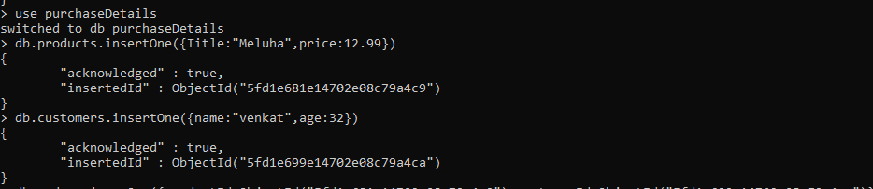

Slide 24
> db.orders.insertOne({productId:ObjectId("5fd1e681e14702e08c79a4c9"),customerId:ObjectId("5fd1e699e14702e08c79a4ca")})
{
"acknowledged" : true,
"insertedId" : ObjectId("5fd1e705e14702e08c79a4cb")
}
>

Slide 25
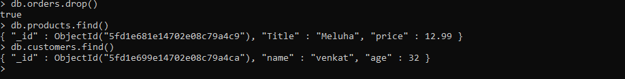
> db.orders.drop()
true
> db.products.find()
{ "_id" : ObjectId("5fd1e681e14702e08c79a4c9"), "Title" : "Meluha", "price" : 12.99 }
> db.customers.find()
{ "_id" : ObjectId("5fd1e699e14702e08c79a4ca"), "name" : "venkat", "age" : 32 }
>

Slide 26
db.customers.updateOne({},{$set:{orders:[{productid:ObjectId("5fd1e681e14702e08c79a4c9"),quantity:2}]}})
{ "acknowledged" : true, "matchedCount" : 1, "modifiedCount" : 1 }
> db.customers.findOne()
{
"_id" : ObjectId("5fd1e699e14702e08c79a4ca"),
"name" : "venkat",
"age" : 32,
"orders" : [
{
"productid" : ObjectId("5fd1e681e14702e08c79a4c9"),
"quantity" : 2
}
]
}
> db.products.findOne()
{
"_id" : ObjectId("5fd1e681e14702e08c79a4c9"),
"Title" : "Meluha",
"price" : 12.99
}
>

Slide 27
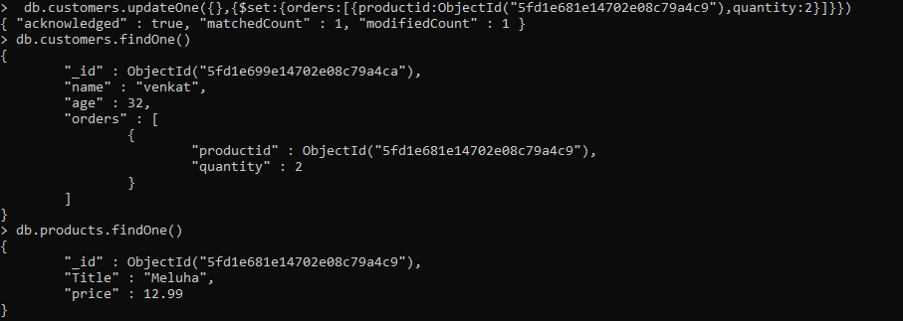

Slide 28
ANOTHER EXAMPLE
> use books
switched to db books
> db.books.insertOne({name:"My fav book",authors:[{name:"venkat",age:32},{name:"sajith",age:29}]})
{
"acknowledged" : true,
"insertedId" : ObjectId("5fd1ea37e14702e08c79a4cc")
}
> db.authors.insertMany([{name:"venkat",age:32,address:{street:"main"}},{name:"sajith",age:29,address:{street:"tree"}}])
{
"acknowledged" : true,
"insertedIds" : [
ObjectId("5fd1ea4ee14702e08c79a4cd"),
ObjectId("5fd1ea4ee14702e08c79a4ce")
]
}
>

Slide 29
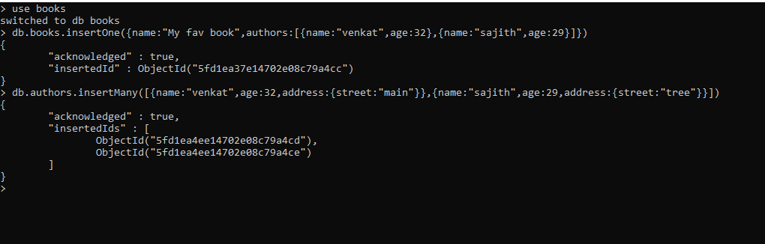

Slide 30
> db.books.updateOne({},{$set:{authors:[ObjectId("5fd1ea4ee14702e08c79a4cd"),ObjectId("5fd1ea4ee14702e08c79a4ce")]}})
{ "acknowledged" : true, "matchedCount" : 1, "modifiedCount" : 1 }
> db.books.findOne()
{
"_id" : ObjectId("5fd1ea37e14702e08c79a4cc"),
"name" : "My fav book",
"authors" : [
ObjectId("5fd1ea4ee14702e08c79a4cd"),
ObjectId("5fd1ea4ee14702e08c79a4ce")
]
}
>

Slide 31
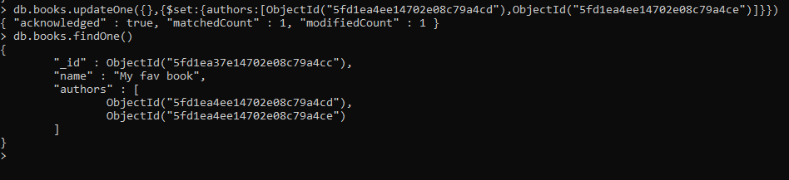

Slide 32
ANOTHER EXAMPLE – BLOG PROJECT
> use text
switched to db text
> db.user.insertMany([{name:"venkat",age:32,email:"venkat@gmail.com"},{name:"akhil",age:21,email:"akhil@gmail.com"}])
{
"acknowledged" : true,
"insertedIds" : [
ObjectId("5fd1ed08e14702e08c79a4cf"),
ObjectId("5fd1ed08e14702e08c79a4d0")
]
}
> db.posts.insertOne({title:"My first post",text:"this is my first post",tags:["new","tech"],
... creator:ObjectId("5fd1ed08e14702e08c79a4cf"),comments:[{text:"i liked the post",author:ObjectId("5fd1ed08e14702e08c79a4d0")}]})
{
"acknowledged" : true,
"insertedId" : ObjectId("5fd1ed4fe14702e08c79a4d1")
}

Slide 33
> db.posts.findOne()
{
"_id" : ObjectId("5fd1ed4fe14702e08c79a4d1"),
"title" : "My first post",
"text" : "this is my first post",
"tags" : [
"new",
"tech"
],
"creator" : ObjectId("5fd1ed08e14702e08c79a4cf"),
"comments" : [
{
"text" : "i liked the post",
"author" : ObjectId("5fd1ed08e14702e08c79a4d0")
}
]
}
>

Slide 34
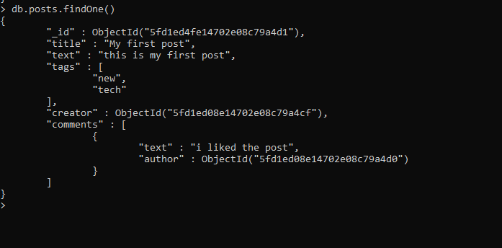

Slide 35
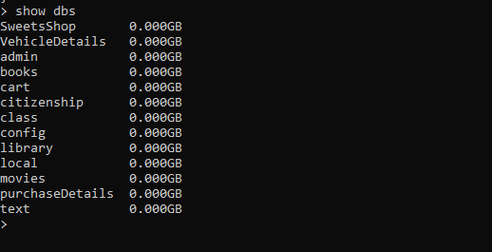

Slide 36
INSERT – WRITE CONCERN

Slide 37
> use details
switched to db details
> db.persons.insertOne({name:"Varadha",Age:21},{writeConcern: {w:1}})
{
"acknowledged" : true,
"insertedId" : ObjectId("5fd21600e14702e08c79a4d2")
}
> db.persons.insertOne({name:"Adithya",Age:21},{writeConcern: {w:1, j:false}})
{
"acknowledged" : true,
"insertedId" : ObjectId("5fd21624e14702e08c79a4d3")
}

Slide 38
> db.persons.insertOne({name:"Adithya",Age:21},{writeConcern: {w:1, j:true}})
{
"acknowledged" : true,
"insertedId" : ObjectId("5fd21635e14702e08c79a4d4")
}
> db.persons.insertOne({name:"Vanshi",Age:21},{writeConcern: {w:1, j:true, wtimeout: 2000}})
{
"acknowledged" : true,
"insertedId" : ObjectId("5fd21646e14702e08c79a4d5")
}
> db.persons.insertOne({name:"Vanshi",Age:21},{writeConcern: {w:1, j:true, wtimeout: 1}})
{
"acknowledged" : true,
"insertedId" : ObjectId("5fd21659e14702e08c79a4d6")
}
>

Slide 39
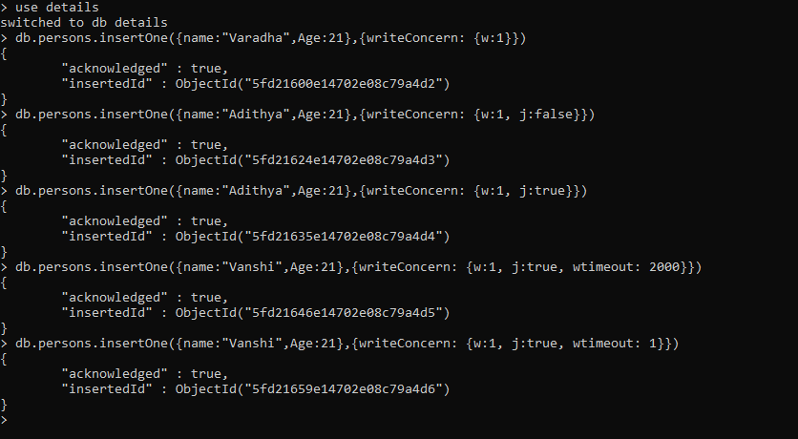

Slide 40
VALIDATOR

Slide 41
> use socialmedia
switched to db socialmedia
> db.createCollection("posts", {
... ... validator: {
... ... $jsonSchema: {
... ... bsonType: "object",
... ... required: ['title', 'text', 'creator', 'comments'],
... ... properties: {
... ... title: {
... ... bsonType: 'string',
... ... description: 'must be a string and it is required'
... ... },
... ... text: {
... ... bsonType: 'string',
... ... description: "must be a string and it is required"
... ... },
... ... creator: {
... ... bsonType: 'objectId',
... ... description: "Must be an object id and this is required"
... ... },
... ... comments: {
... ... bsonType: 'array',
... ... description:'Must Be an array',
... ... required: ['text', 'author'],
... ... items: {
... ... properties: {
... ... text: {
... ... bsonType: 'string',
... ... description: "must be a string and required"
... ... },
... ... author: {
... ... bsonType: 'objectId',
... ... description: "must be an objectId and required"
... ... }
... ... }
... ... }
... ... }
... ... }
... ... }
... ... }
... ... })
{ "ok" : 1 }
>

Slide 42
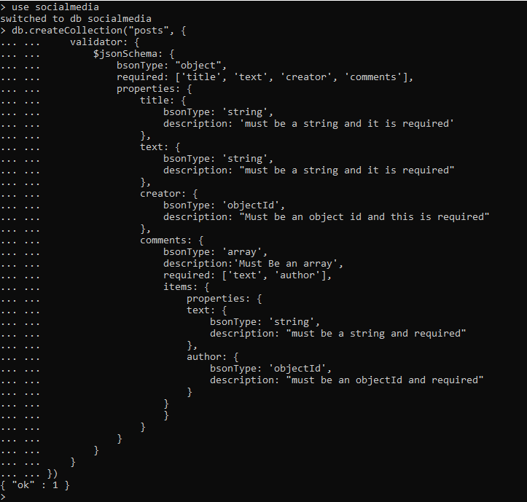

Slide 43
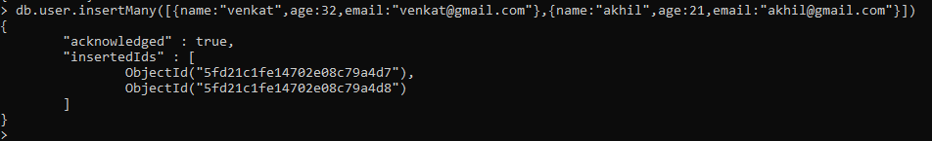
> db.user.insertMany([{name:"venkat",age:32,email:"venkat@gmail.com"},{name:"akhil",age:21,email:"akhil@gmail.com"}])
{
"acknowledged" : true,
"insertedIds" : [
ObjectId("5fd21c1fe14702e08c79a4d7"),
ObjectId("5fd21c1fe14702e08c79a4d8")
]
}
>

Slide 44
VALIDATOR SCHEMA TEST
db.posts.insertOne({title:"My first post", text:"MongoDB is a NO Sql Database",creator:ObjectId("5fd21c1fe14702e08c79a4d7"),comments:[{text:"I will try MongoDB",author:123}]})

Slide 45
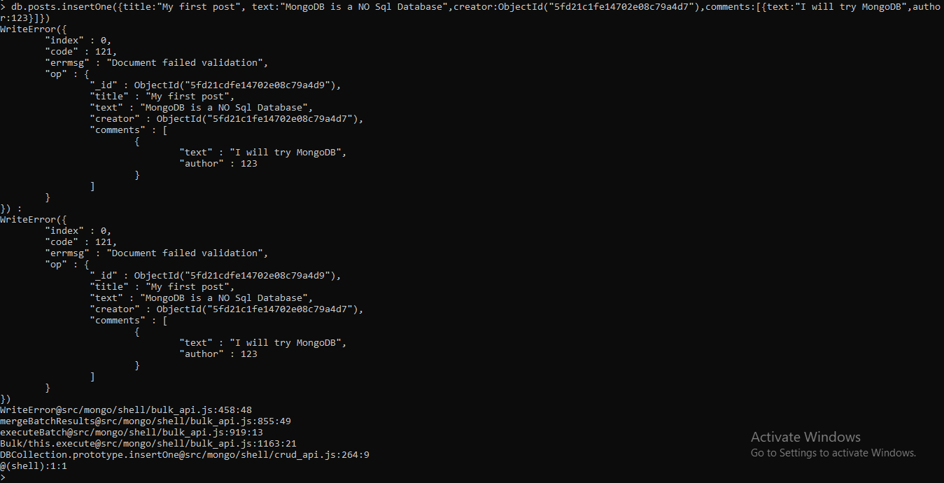

Slide 46
> db.posts.insertOne({title:"My first post", text:"MongoDB is a NO Sql Database",creator:ObjectId("5fd21c1fe14702e08c79a4d7"),comments:[{text:"I will try MongoDB",author:ObjectId("5fd21c1fe14702e08c79a4d8")}]})
{
"acknowledged" : true,
"insertedId" : ObjectId("5fd21e4be14702e08c79a4da")
}
>

